Slide 1

DEPARTMENT OF
CSE (ARTIFICIAL INTELLIGENCE AND MACHINE LEARNING)
ACADEMIC YEAR 2025 - 2026
SEMESTER III
ARTIFICIAL INTELLIGENCE LABORATORY
MINI PROJECT REVIEW
Artificial Intelligence in Constraint Satisfaction: A Multi-Game Approach
REGISTER NUMBER | 2117240030078
NAME | S MALAVIKA
YEAR | II
SECTION | AIML-B
FACULTY IN-CHARGE | Mrs. M. Rubina begam

Slide 2
PROBLEM STATEMENT
This project addresses the challenge of making abstract Constraint Satisfaction Problem (CSP) concepts in Artificial Intelligence accessible and understandable. Current teaching methods present CSPs as complex mathematical formulations without interactive, practical demonstrations, creating significant learning barriers.
Core Problems:
Abstract concepts lack tangible representation
No unified platform showing CSP applications across domains
Passive learning materials limit engagement
No real-time feedback during problem-solving
Project Objective: Develop an interactive web portal featuring three CSP-based games (N-Queens, Sudoku, Map Coloring) that provides visual feedback, automated solving, and guided learning

Slide 3
THEORETICAL BACKGROUND
Theoretical Background
Constraint Satisfaction Problems (CSPs)
CSPs involve finding assignments to variables that satisfy given constraints. Defined by:
Variables: Entities to determine
Domains: Possible values
Constraints: Rules governing valid combinations
Problem Models:
N-Queens: Place queens avoiding attacks
Sudoku: Fill grid following row/column/box rules
Map Coloring: Color adjacent regions differently
Algorithm Selection: Backtracking with Forward Checking
Selected for:
Educational Value: Clear step-by-step process
Visualization: Easy to demonstrate constraint propagation
Adaptability: Works across all three problem types
Foundation: Basis for understanding advanced methods
This approach optimally balances educational clarity with practical implementation for interactive learning.

Slide 4
IMPLEMENTATION AND CODE
Link to code in Git-hub Repository
List | Git-hub Repository Links
Implementation of Code Link | https://github.com/webtech257/ai_mini_project
Word Document Report Link | https://github.com/webtech257/ai_mini_project/blob/main/project%20pdf.pdf
PPT Link

Slide 5
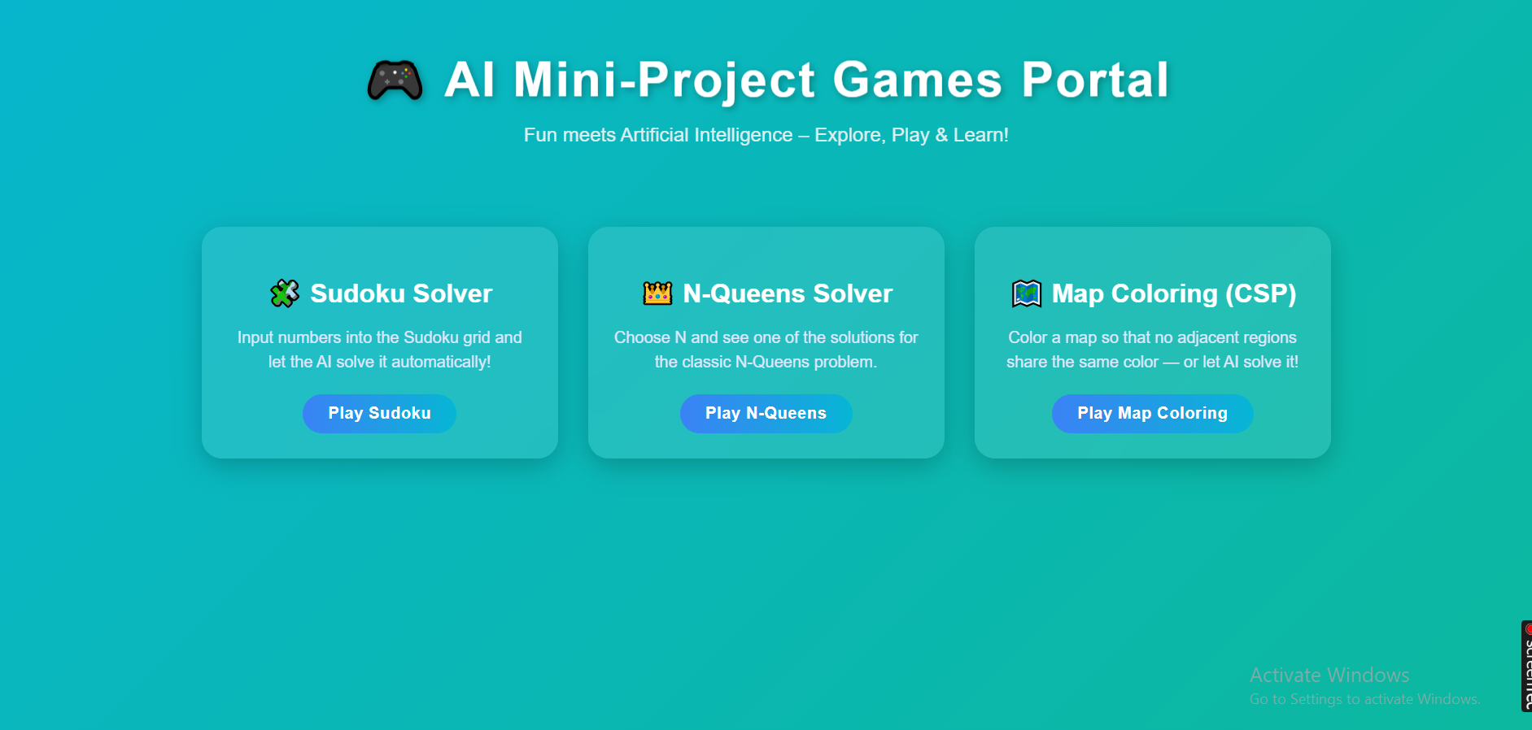
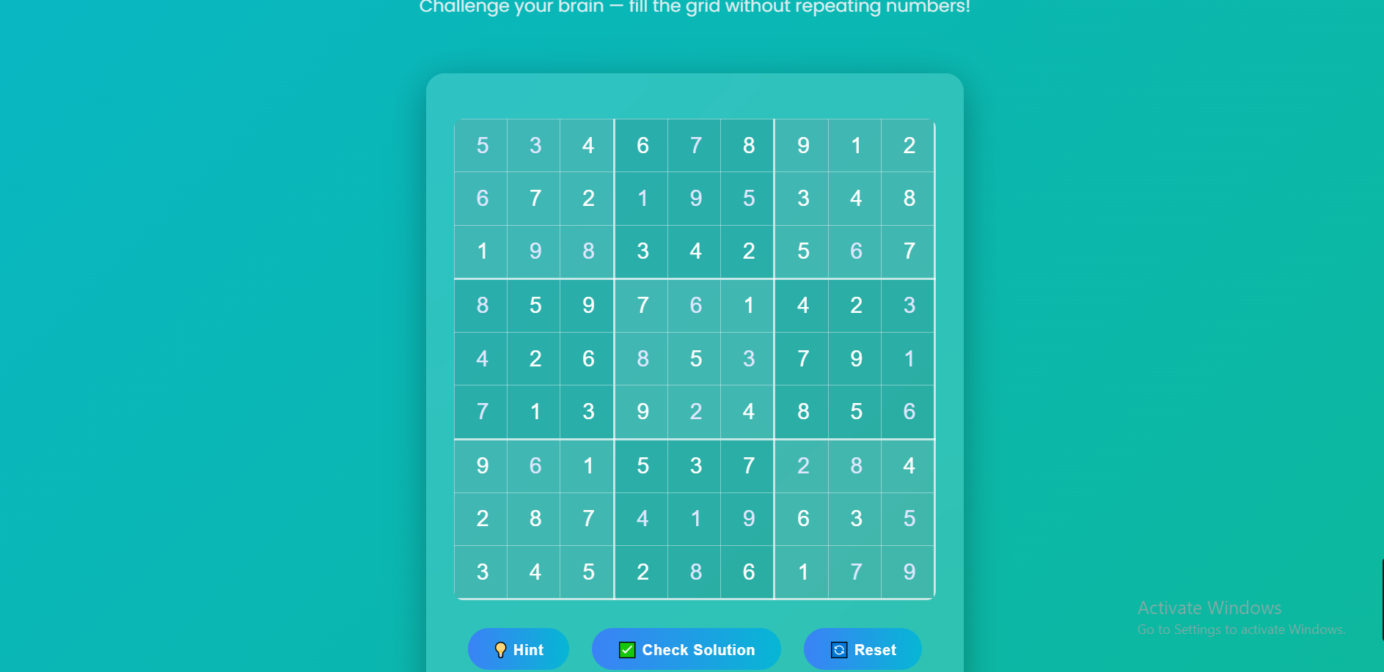
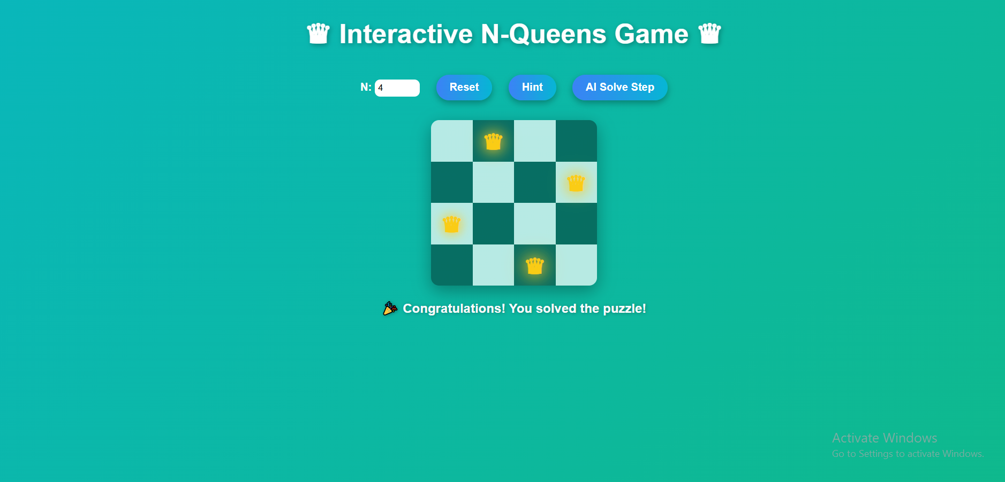
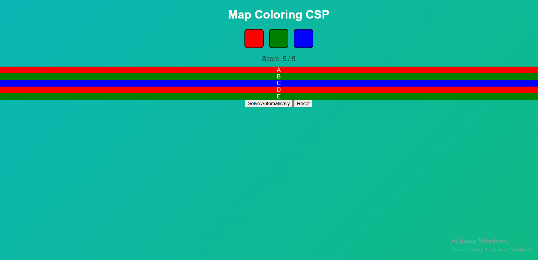
OUTPUT AND RESULTS

Slide 6
OUTPUT AND RESULTS
RESULTS ACHIEVED
✅ Interactive portal with 3 CSP games
✅ Visual constraint feedback
✅ Real-time conflict detection
✅ Unified algorithm for all problems
Future Enhancements
FUTURE ENHANCEMENTS
Short-term:
  Step-by-step visualization
  Difficulty levels
  More CSP problems
Medium-term:
  Intelligent tutoring system
  Multi-algorithm comparison
  Collaborative features
Long-term:
  AI-powered adaptation
  Automated problem generation

Slide 7
REFERENCES
Russell, S., & Norvig, P. (2020). Artificial Intelligence: A Modern Approach (4th ed.). Pearson. - CSP fundamentals
Kumar, V. (1992). "Algorithms for Constraint Satisfaction Problems: A Survey". AI Magazine - Backtracking algorithms
Mackworth, A.K. (1977). "Consistency in Networks of Relations". Artificial Intelligence - Constraint propagation
Knuth, D.E. (2000). "Dancing Links". arXiv:cs/0011047 - Exact cover problems
Minton, S., et al. (1992). "Min-Conflicts: A Heuristic for CSPs". Artificial Intelligence - Local search

